Slide 1
Working with Git & GitHub – Git Workflows – Pull Based Model
Dr. Ritu Arora
Associate Professor (Off-Campus)
Department of Computer Science & Information Systems
BITS, Pilani

Slide 2
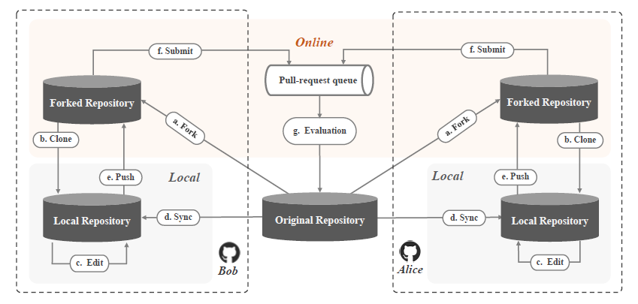
Workflow of Pull based development model
Figure depicting workflow of Pull based development model
Image adapted from: Z. Li et al., "Redundancy, Context, and Preference: An Empirical Study of Duplicate Pull Requests in OSS Projects," in IEEE Transactions on Software Engineering, doi: 10.1109/TSE.2020.3018726.

Slide 3
Git Workflow: Pull Based Model
Open Source Software projects follow the Pull-based workflow as described below:
The workflow is described as follows:
Fork the project to your GitHub account
Clone the forked repo to your local machine
Create a topic branch from the master branch
Edit the project (as required) and then commit the changes done
Push the new created branch onto your forked repo on GitHub
Create a open Pull Request on GitHub to the open source project
The project owner reviews, merges and/or closes the Pull Request
Sync your fork repo with the updated master

Slide 4
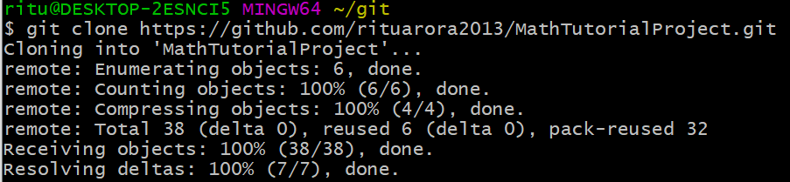
Git Workflow: Pull Based Model
Fork the project to your GitHub account:
Login into your GitHub account
Navigate (or search) to the repo you wish to contribute to
Click the “Fork” button on the right-side of the page
A copy of the repo will be created in your GitHub account
Clone the forked repo to your local machine

Slide 5
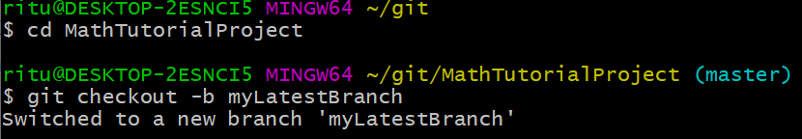
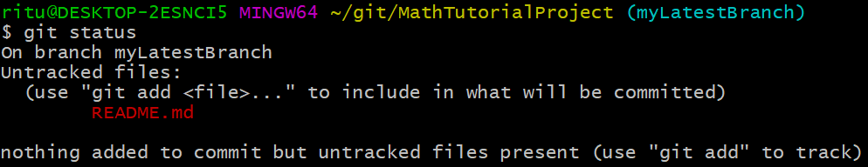
Git Workflow: Pull Based Model
Create a topic branch from master branch
Make some changes and commit them to the project
Suppose we add ReadMe.md file and move the same to the staging area and then commit

Slide 6
Need for Branching
Helps to work in isolation
It can orchestrate parallel development allowing developers to work on tasks simultaneously as part of a team
And parallel builds and testing ensure developers get the feedback they need quickly
Parallel tasks possible by creating multiple branches
While you wait for changes from one branch to be pulled by the owner, you may start your work on another branch

Slide 7
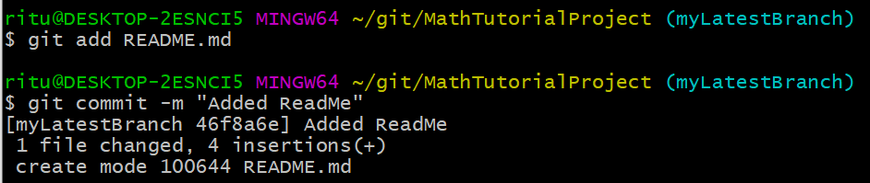
Git Workflow: Pull Based Model
Use the git add command to add the untracked files to the staging area and then commit

Slide 8
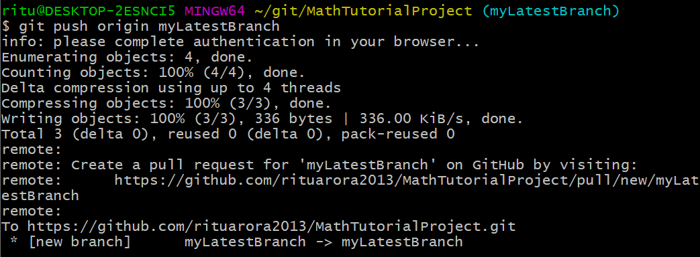
Git Workflow: Pull Based Model
Push the new created branch onto your forked repo on GitHub

Slide 9
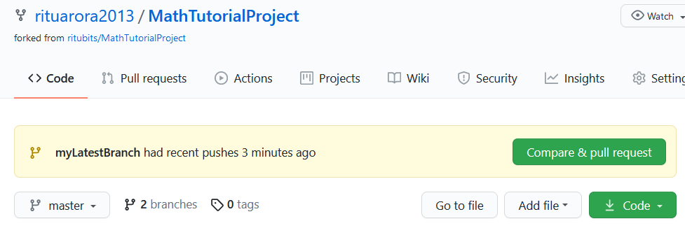
Git Workflow: Pull Based Model
Navigate back to the forked repo on GitHub – you will see that GitHub has noticed that a new topic branch has been pushed.
It will present you with a big green button, with the label “Compare and Pull request”. This option helps to review the changes and open a Pull Request to the original project.

Slide 10
Creating a Pull Request using GitHub
Click on the “Compare and Pull request” button and fill the title and description for the same.
This is important as it let’s the owner or maintainer of the project understand the changes proposed by you.
Moreover, you will also be able to see the list of commits in the topic branch that are ahead of the master branch.
And a unified diff of all the changes that will be made if the branch is merged by the owner.
Click the “Create Pull Request” Button – the owner will be notified through an email and through GitHub notifications, that someone has suggested changes to the repo.

Slide 11
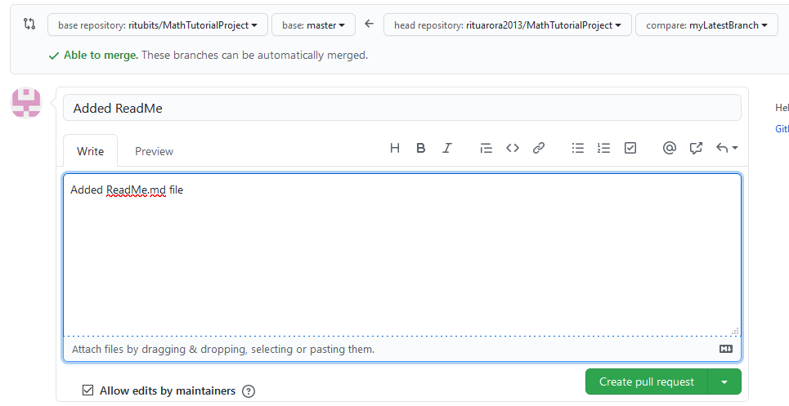
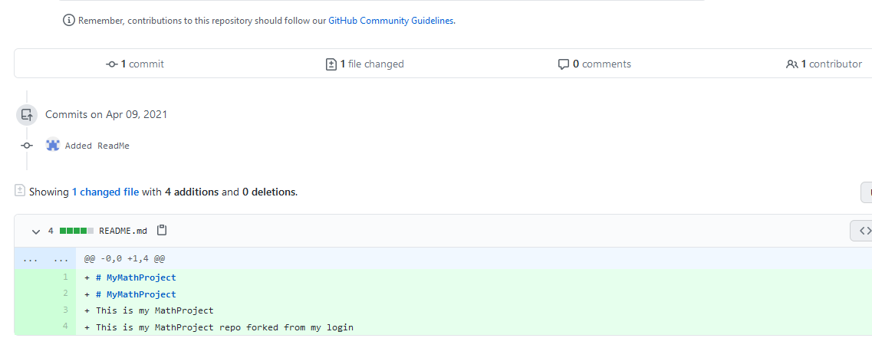
Figure depicting creation process of a Pull Request

Slide 12
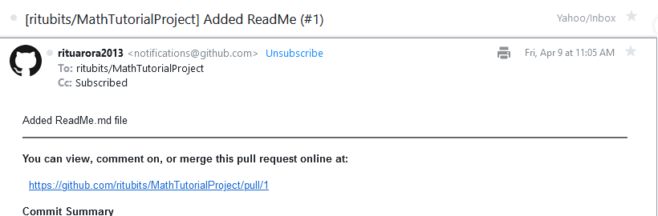
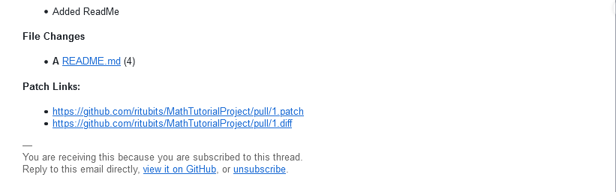
Figure depicting email notification received by the owner/maintainer of the public project repo

Slide 13
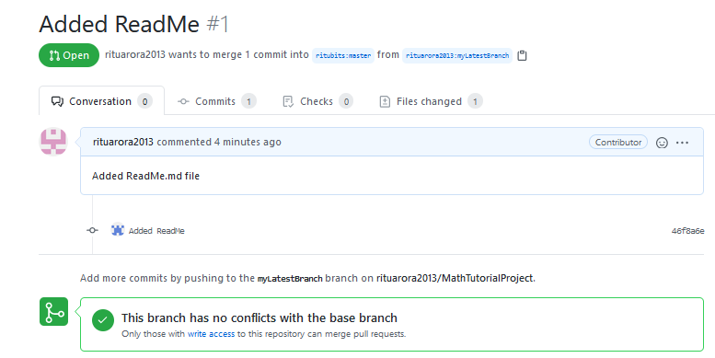
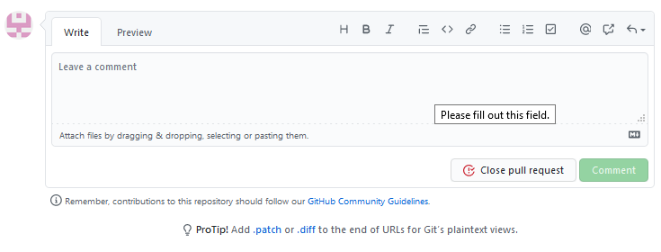
Figure depicting GitHub notification received by the owner/maintainer of the public project repo

Slide 14
Iterating on a Pull Request using GitHub
Now the project owner needs to look at the suggested changes and merge them or reject them or provide additional comments.
The project owner may discuss over the proposed changes through email or through GitHub.
Additionally, the owner may also review the unified diff and comment by clicking on any of the lines.
Once the owner places a review comment, the creator of the pull request will get a notification through email and through GitHub notifications.
Additionally, all other collaborators, including those watching the repo, will also be notified through an email.
A pull request discussion page would also be created where all can comment.

Slide 15
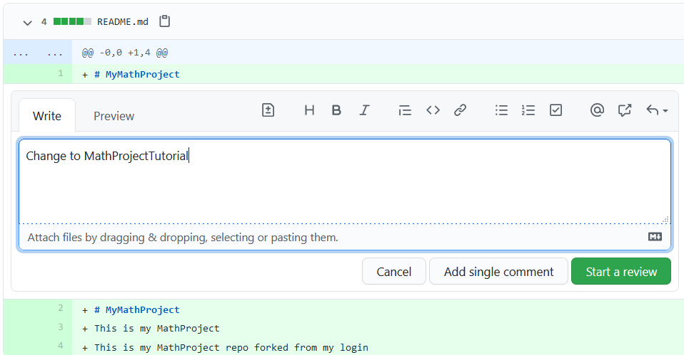
Iterating on a Pull Request using GitHub
Figure depicting reviewing of selected lines in a pull request

Slide 16
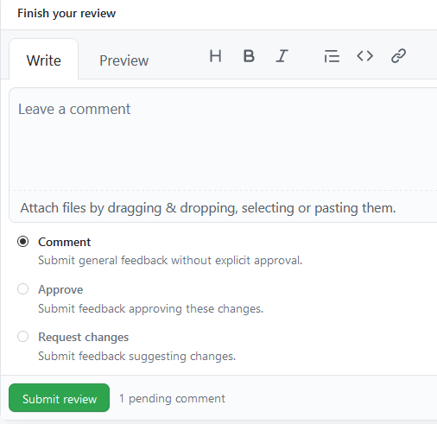
Iterating on a Pull Request using GitHub
Figure depicting reviewing of selected lines in a pull request

Slide 17
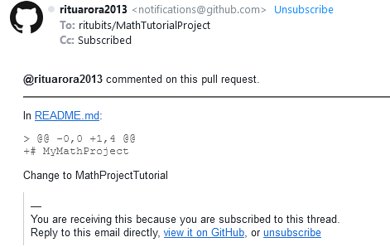
Iterating on a Pull Request using GitHub
Figure depicting email notification received by the creator of the pull request

Slide 18
Iterating on a Pull Request using GitHub
The creator of the pull request may now make changes as suggested by the owner of the project.
He would make changes to branch he was working on and push it again on the GitHub.
This will modify the existing Pull request and notify the project owner through email and discussion page.

Slide 19
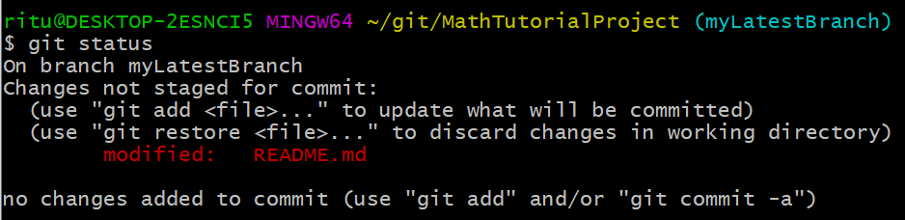
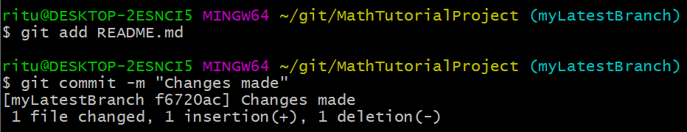
Iterating on a Pull Request using GitHub
The contributor makes changes to ReadMe.md file and does a status check which reflects the changes:
The contributor now adds the file to staging area and commits the changes:

Slide 20
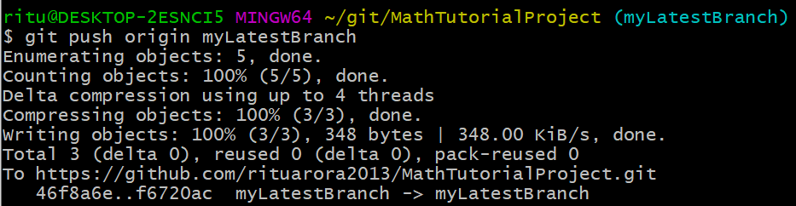
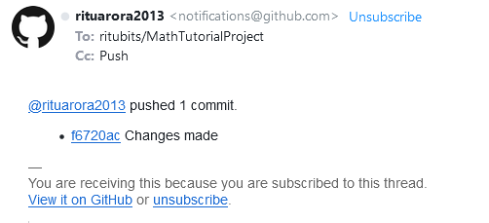
Iterating on a Pull Request using GitHub
Next, the contributor pushes the changes back to the forked repository:
The Project owner will be
notified through email:

Slide 21
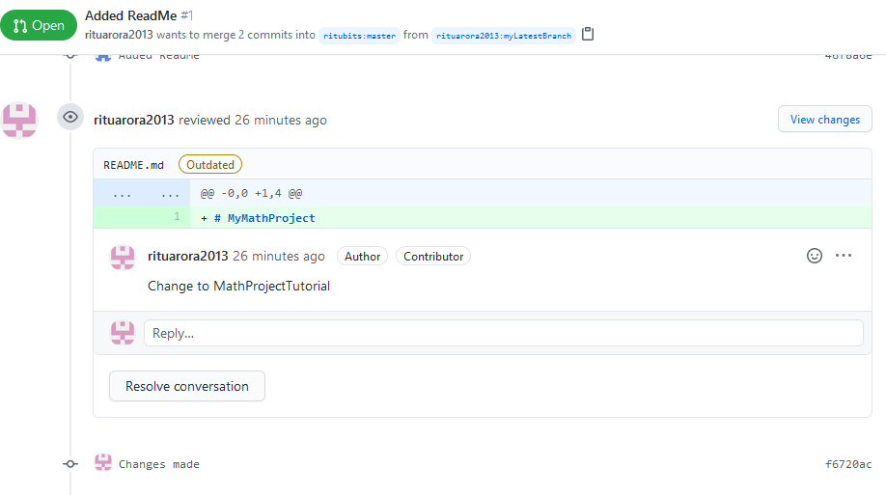
Iterating on a Pull Request using GitHub
Figure depicting changes made to pull request

Slide 22
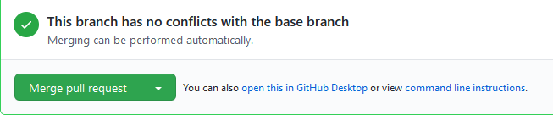
Merging a Pull Request using GitHub
The project owner may now merge the request if there are no conflicts.

Slide 23
Sync the Forked GitHub Repo Using A Reverse Pull Request
A forked repo exists independent of the public repo from which it has been forked.
Keeping the forked repo in sync with the parent repo will reduce the chances of merge conflicts.
Moreover, if the original repo has new commits, GitHub informs all the forked repos through messages like:
However, the GitHub will not update the forked repo automatically. This task has to be done by the owner of the forked repo manually.
This branch is 4 commits behind MyMathProject:master

Slide 24
Sync the Forked GitHub Repo Using A Reverse Pull Request
You need to do the following two tasks for doing this:
Task 1: Sync on GitHub
Create a pull request (called Reverse Pull) using GitHub to update the forked repo from the original repo
Task 2: Sync on local machine
Use the git pull command in git bash to update the local clone

Slide 25
Sync the Forked GitHub Repo Using A Reverse Pull Request
Task 1: On GitHub
Navigate to the forked repo and click on the “New pull request” button
On the next page, choose your forked repo as the base repo -> then click -> Compare across forks
Then choose the head repo as original repo from where you created this forked repo
Give appropriate message and “Create Pull request”
You will see a pull request created in your forked repo.
Navigate to the pull request, review the changes and merge.

Slide 26
Sync the Forked GitHub Repo Using A Reverse Pull Request
Task 2: Sync on local machine
Navigate to the project folder on your machine
Checkout master branch, if you are currently on some other branch and run the following commands:
$ git checkout master
$ git pull

Slide 27
Thank You!
In our next session:
Tools and Technologies used in OSSE

